Slide 1
Motivation and Emotion
Chapter 10

Slide 2
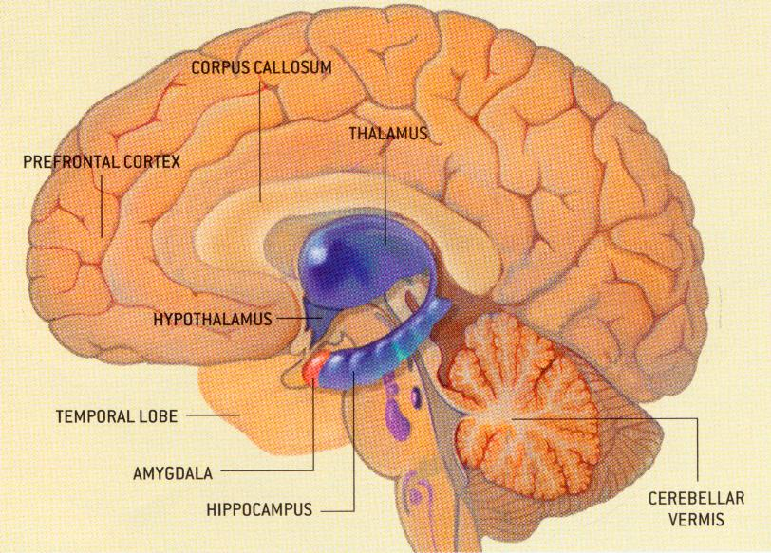
Motivation
What areas of the brain control motivation and emotion?

Slide 3
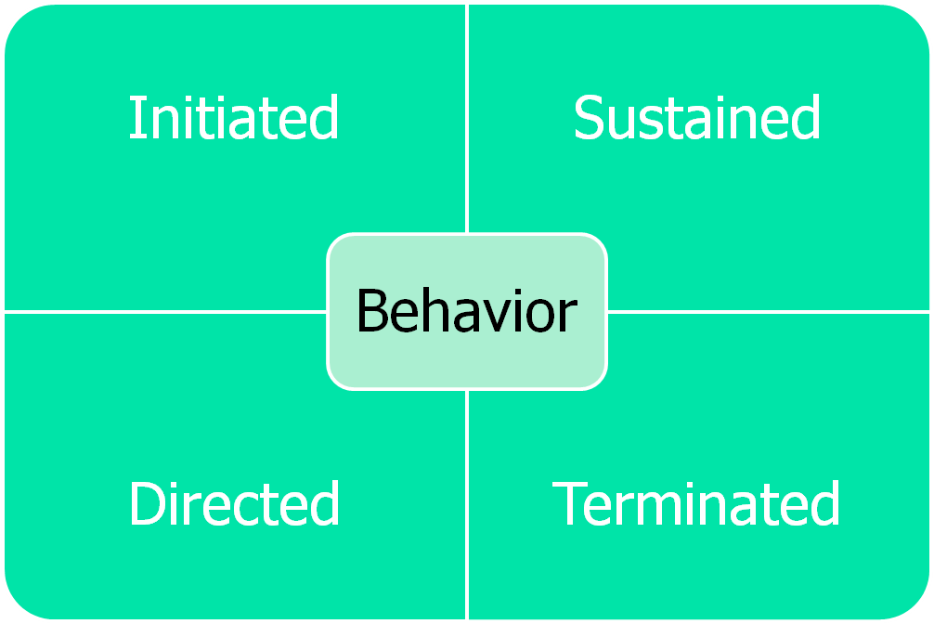
Motivation
Motivation
  Intrinsic
  Extrinsic

Slide 4
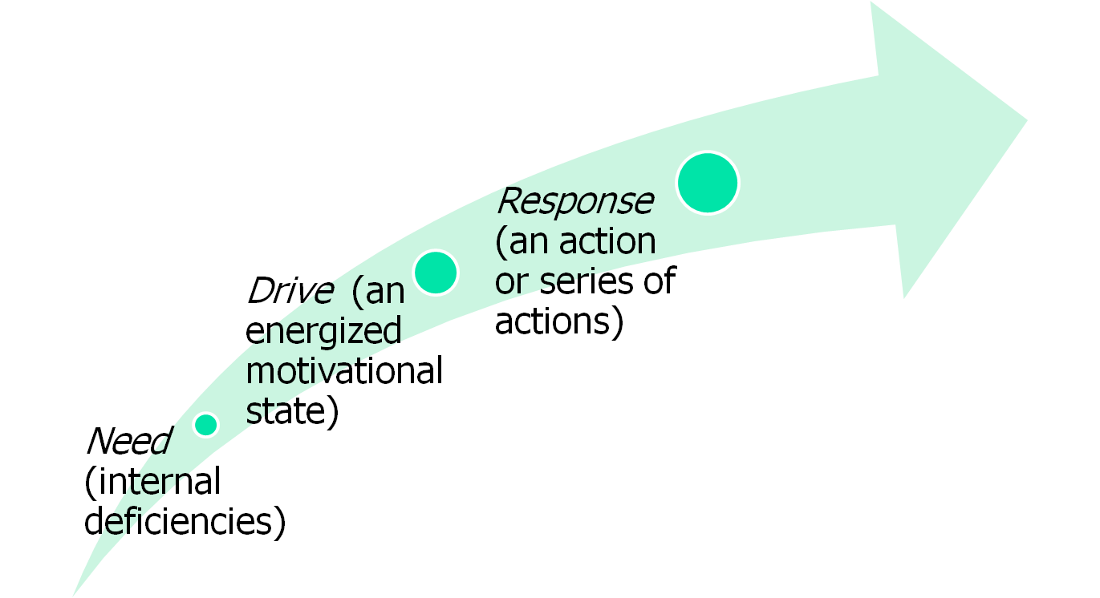
Motivation
Goal (the target of motivational behavior)

Slide 5
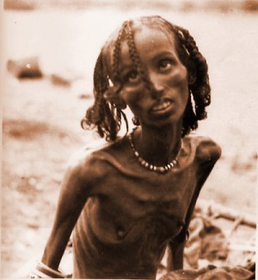
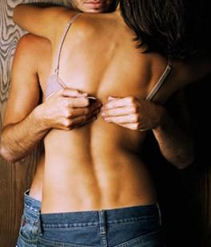
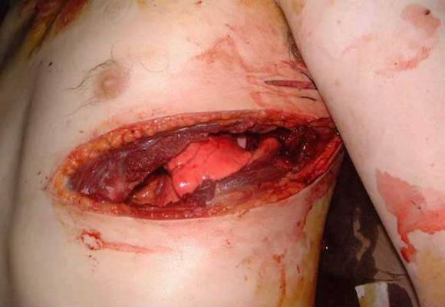
Emotion
Key biological motivators
  Hunger
  Thirst
  Pain
  Sex

Slide 6
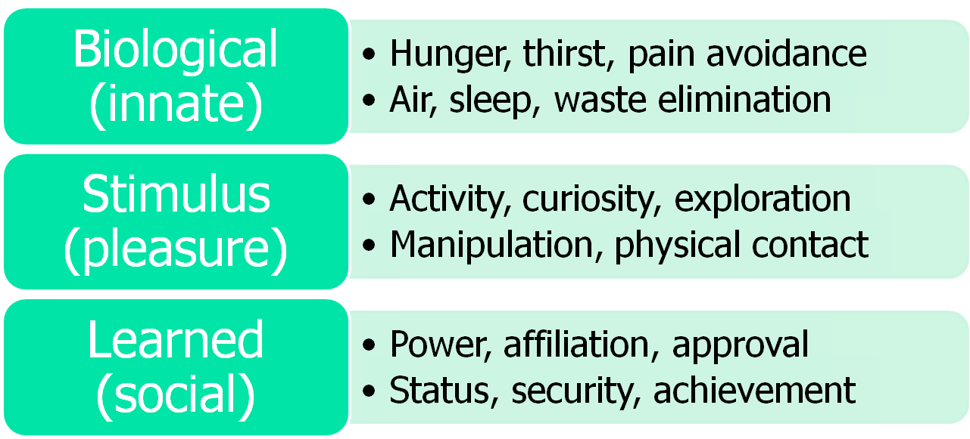
Emotion
Self-Reflect questions (page 343)

Slide 7
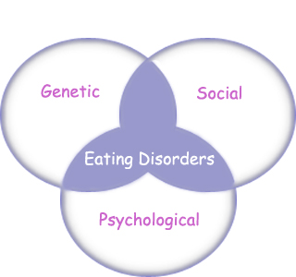
Emotion
External factors in hunger and eating
  Taste
  Emotions
  Cues
  Culture
  Dieting
  Disorders
    Anorexia
    Bulimia
    Obesity

Slide 8
Emotion
Emotion
  Physiological arousal
    Heart rate, blood pressure, perspiration, and bodily stirrings
  Gestures
  Posture
  Expressions
    Outward signs
  Feelings
    Inward experiences

Slide 9
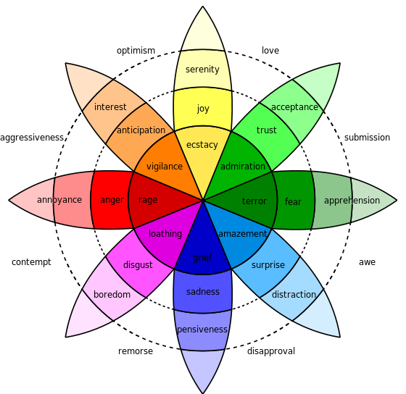
Emotion
Primary emotions
Gender and emotions
Culture and emotions

